Slide 1

Reactive Extensions
A short & basic introduction
By
Grzegorz Jachimko

Slide 2
RX – the big picture
LINQ
Reactive Extensions
Task Parallel Library
.net platform - APM
Operating System

Slide 3
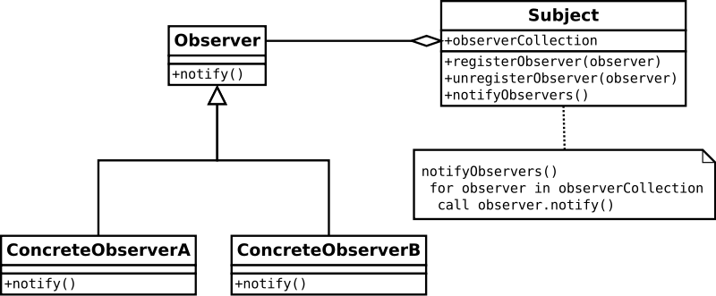
RX – it is all about the Observer
http://http://en.wikipedia.org/wiki/Observer_pattern

Slide 4
Observer in .net
Two basic interfaces:
interface IObserver<TSource>
{
void OnNext(TSource item);
void OnCompleted();
void OnError(Exception err);
}
Interface IObservable<TResult>
{
IDisposable Subscribe(IObserver<T> observer)
}
It is all about „push” vs „pull” model…

Slide 5

Lets have a look at the details - IObservable
Simple interface - IDisposable Subscribe(IObserver)
Why bother with disposable?
How about…
Exception handling?
Completition?
Extensions methods!!!

Slide 6
Lets have a look at the details - IObserver
Yet another simple interface…
OnNext
OnCompleted
OnError
How do we create them?
Factory methods!!! – Return, Start, Create
Some other handy methods
Empty
Throw
Never
From events
From tasks
From async

Slide 7

I’ve heard something about Subjects…
What a subject is?
Subject types:
Subject<T>
ReplaySubject<T>
BehaviourSubject<>
AsyncSubject<T>
How and when to use them?

Slide 8
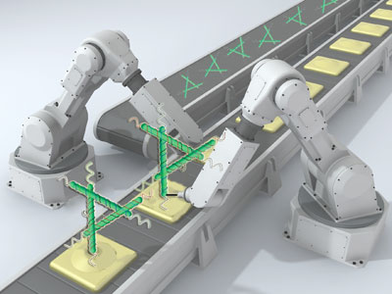
Sequence manipulation
It is almost as simple as with LINQ!
Where
Distinct / DistinctUntilChanged
Skip / Take
SkipWhile / SkipUntil / TakeWhile / TakeUntil
There is some extra flavour to:
Count, Min, Max, Sum, Avergage
I said almost like LINQ, because there are:
First, Last
Single

Slide 9
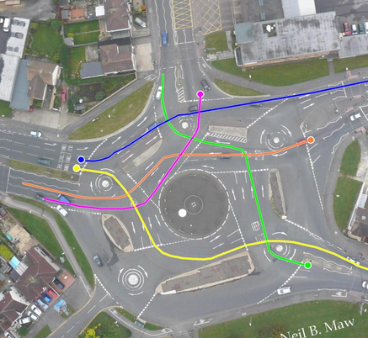
What if I want to aggregate?
Nothing fancy– use following:
Aggregate
Scan
Min / Max
MinBy / MaxBy
GroupBy

Slide 10

And there are also nested seqences
Sequence of a sequence
IObservable<IObservable<T>> what is this?
Let’s say – whenever I type a partial city name, I’d like to get instant auto suggestion of all matched cities…
This translates to:
P → Piła, Płock, Poznań, Polkowice, Poręba
Po → Poznań, Polkowice, Poręba
Poz → Poznań

Slide 11

How to understand it?
An image is worth 1.000 words…
Sequence is a horizontal line
Time moves to the right
Notification is one of:
OnNext = 0
OnCompleted = |
OnError = X
So:
0-0-0-| sequence completed with 3 elements
0-X | sequence completed with error after producing
-| empty sequence
--- sequence which didn’t complete nor produced anything

Slide 12
So going back to the example…
- - 0 - - - - - - - - - - - - - - 0- - - - - - - - - - - 0 - - - - -
(P) (Po) (Poz)
---------0-------0-------------0-----------------0-I
(Piła) (Poznań) (Polkowice) (Poręba)
--------0---------0-------0-I
(Poznań)(Polkowice)(Poręba)

Slide 13

What do I do with it?
Combine!
Merge
Switch
Amb
Zip
CombineLatest
Concat
StartWith

Slide 14
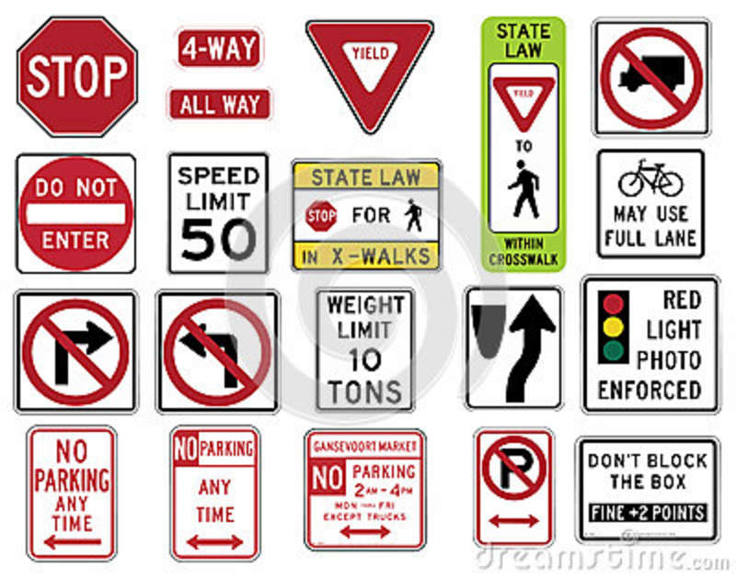
Some control flow instructions
Using
Catch
Finally
Retry
OnErrorResumeNext
Deffer
Repeat
Delay
Timeout
Throttle

Slide 15
That’s pretty much, when it comes to basics….
Thanks for your attention!
If you have questions –
grzegorz.jachimko@rulefinancial.com

